Slide 1
Exploring Explanations for Matrix Factorization Recommender Systems
Bashir Rastegarpanah Boston University bashir@bu.edu
Mark Crovella Boston University crovella@bu.edu
Krishna P. Gummadi Max Planck Institute for Software Systems gummadi@mpi-sws.org

Slide 2
1 Introduction
One can distinguish neighborhood methods, based on computing similarities between items or users
from matrix factorization, which assigns items and users to a latent space in which inner product captures the affinity of a user for an item.

Slide 3
1 Introduction
• Matrix factorization (MF) methods, on the other hand, can be more accurate than neighborhood methods, but pose a greater challenge from an explanation standpoint.
• Matrix factorization methods make use of the entire set of previous recommendations – over all users and items – in formulating a single recommendation for a given user.
• Matrix factorization methods solve a non-convex optimiza- tion via heuristic methods, whose functioning can be quite opaque.

Slide 4
1 Introduction
Our current work investigates two sets of corresponding questions:
(1) In a context where multiple items (and users) can be said to have contributed to forming a recommendation, what is the most meaningful or useful feedback to give a user to explain a single recommendation?
(2) Given the complexity of MF approaches, are there approximate representations of the behavior of MF algorithms that we can use to construct such useful feedback?

Slide 5

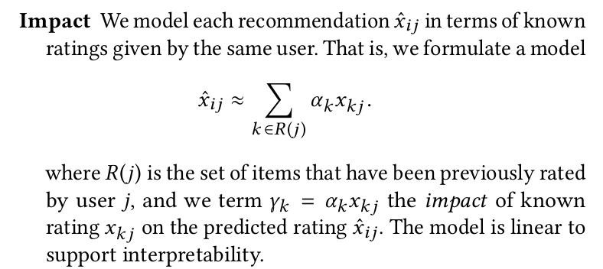
2 EXPLANATIONS
Assume x i j indicates the rating given by user j to item i.
In such a setting, user j may ask:
(1) Which previous ratings have contributed the most to the
predicted rating ?

Slide 6
2 EXPLANATIONS
Assume x i j indicates the rating given by user j to item i.
In such a setting, user j may ask:
(1) Which previous ratings have contributed the most to the
predicted rating ?

Slide 7

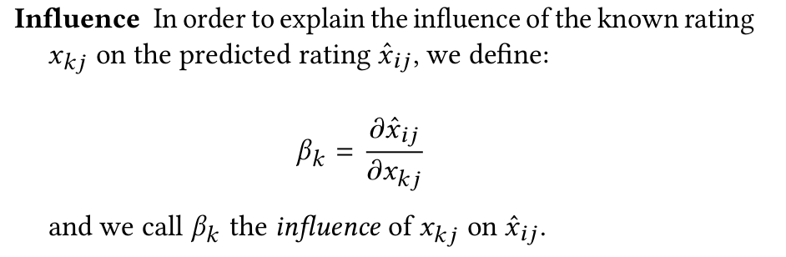
2 EXPLANATIONS
(2) Which previous ratings have the most influence over the predicted rating ? In other words, if things were different – e.g., different ratings had been provided in the past – which differences would matter most?

Slide 8

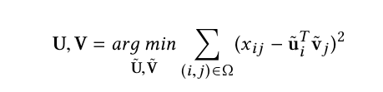
3 ALGORITHMS
The unknown ratings are then estimated by setting

Slide 9


3 ALGORITHMS
We define W j to be a binary matrix with 1s on the diagonal in positions corresponding the known entries of x j .

Slide 10
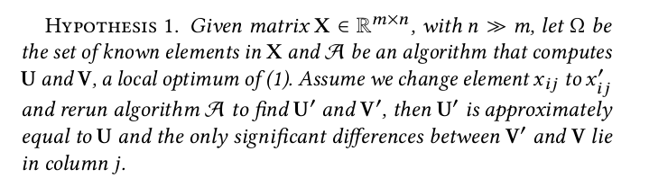
3 ALGORITHMS

Slide 11

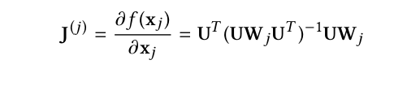
3 ALGORITHMS
the influence matrix of each user j only depends on U and on the set of items that have been previously rated by user j.

Slide 12
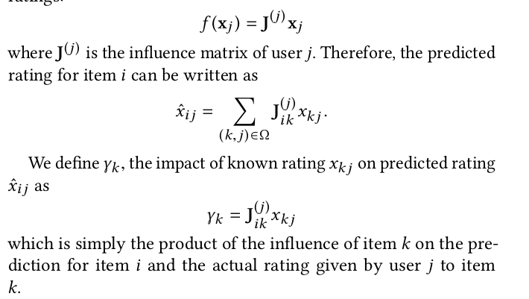
3 ALGORITHMS
Next, we turn to approximating impact. In section 2 we showed that the following linear model describes the output of an MF recommender system for user j as a function of his known ratings:

Slide 13

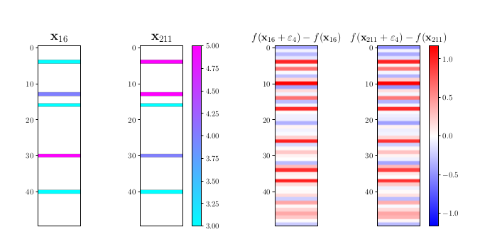
4 EXAMPLE
changing the rating given by user a to item i (x ia ′ ← x + ε ) and changing the rating given by user b to item i by the same amount (x ib ′ ← x + ε ) should have an identical effect on the predicted ratings for all other items. In other words, we have:

Slide 14
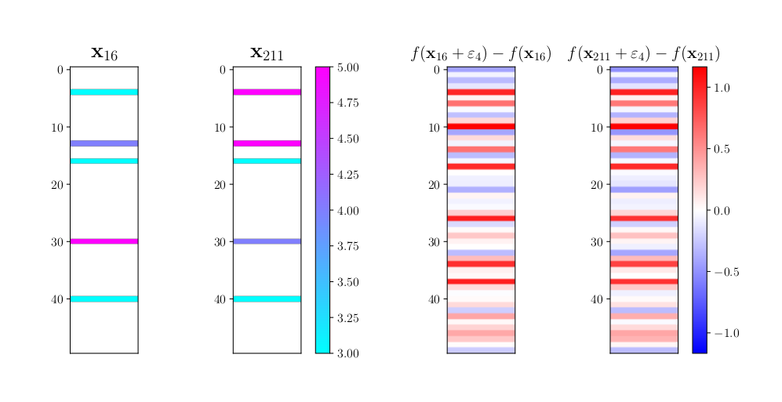
4 EXAMPLE

